Slide 1
Educator Effectiveness Process
Introduction to the Grant
and Guide to the Unit Meeting

Slide 2
Learning Goals
At the end of this session, the teacher will be able to:
Make the connection between the importance of the unit meeting to the Educator Effectiveness Process
Understand Role of the Unit Meeting
Participate Effectively in Unit Meetings
Create Effective Unit Meetings

Slide 3
Overview
Four Core Processes
A: Differentiated Performance–based Compensation System (PBCS)
B: Transparent, Rigorous, and Fair Observations
C: Practical Targeted Professional Development
D: Professional Career Options
Think-Pair-Share

Slide 4
Core Process A
A differentiated performance based compensation system (PBCS) that allows for differentiated payments to educators based on teacher value-added student performances, and principal and teacher observations.
3 Models: Tested Core Subject, Non-Tested Subjects, Principal

Slide 5
Payout Models

Slide 6
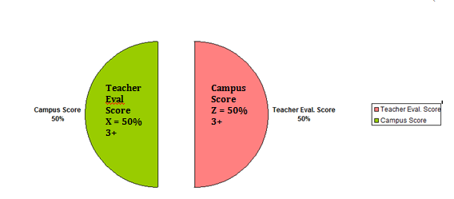
Core-Subject Not Tested
Observations
Value-Added

Slide 7
Math
English
School Value-Added
Observations
Class Value-Added

Slide 8
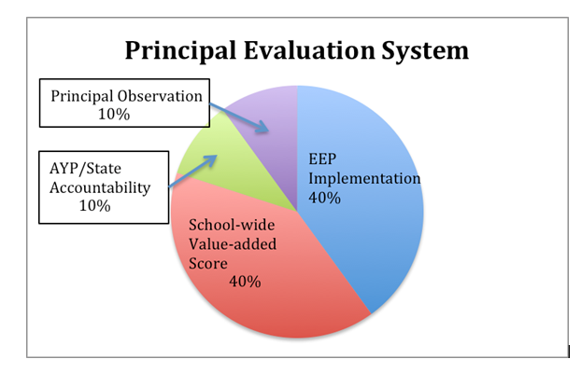

Slide 9
Value-Added
Statistical measurement of student gains in achievement over a year based on performance on state assessment
EVAAS – analyzes student data and predicts student performance
Battelle for Kids – links student data to teachers
Measures how much value a teacher added to a student’s academic growth over a year.

Slide 10
Core Process A
Which payout category do you fall into?
What is your payout scheme?

Slide 11
Core Process B
Transparent, rigorous, and fair observations that occur throughout the year and use pre and post observer-teacher conferences that focus on the standards-based instructional rubrics including plans for growth.

Slide 12
Core Process B
Observations that are
Transparent
Fair
Rigorous
Based on Observation Rubric
Occur three times in the year

Slide 13
Observations
Observers are trained and certified by EEP and Region 20.
Teachers are observed by three different observers
Recorded in TEDS (Teacher Evaluation Data System)
Inter-rater reliability assured
Aligned to value-added scores

Slide 14
Observations
One announced, Two unannounced
Reinforcement Goal
Refinement Goal
Pre-Conference
Observation
Scoring
Post-Observation
Conference
Walk through
Observations

Slide 15
Observation Rubric
Domain I – Facilitating Student Learning
Domain II – Planning For Learning
Domain III – Mental, Physical, Emotional Learning
Domain IV – Campus Responsibilities

Slide 16
Observation Rubric
Guide to measure teacher effectiveness
Scored in each Indicator
Scores: 1 – 5
Recorded in TEDS
Need an average score of 3 to qualify for payout.
Accounts for 50% of payout for all teachers.
Focus of Unit Meetings

Slide 17
Domain 1. Facilitating Student Learning | Learning Goals Rigor Differentiation Hands-On Learning Comprehensible Input Time Management Formative Assessment Checking for Understanding Student Engagement Cooperative Learning Student HOTS Active Learning
Domain 2. Planning for Learning | Learning Structure Learning Tasks Evidence of Learning
Domain 3. Mental Physical & Emotional Learning | Behavior Norms Positive Mental Attitude Learning Climate Learning Interactions

Slide 18
Observation Rubric
Designed to evaluate teachers’ planning, instruction and assessment skills
Post-conference provides opportunity to reflect on their lessons.
Levels of Performance
5 = Outstanding; Observation indicates all or more than all of the criteria was met
4 = Above Effective; Observation indicates all or most of the criteria was met
3 = Effective; Observation indicates most of the criteria was met
2 = Below Effective; Observation indicates some of the criteria was met
1 = Unsatisfactory; Observation indicates little or none of criteria was met

Slide 19
Core Process B
What is the purpose of the post-conference?
Which indicators do you think you will need the most help with?
Which indicators are your strengths?
How many evaluations will you have by the end of the year?

Slide 20
Core Process C
A comprehensive practical-use professional development system
Based on each high-need school's educator evaluative and student assessment data.

Slide 21
Core Process C
Job-embedded Professional Development
Targeted development Training
Include weekly Unit Meetings
Based on School Plan
Include Individual Growth Plans

Slide 22
The School Plan
Developed by Leadership Team and based on data
Goal is to improve student achievement
Used to monitor progress
Include cycle goals and unit goals
School goal: broad, identify gaps
Unit goal: specific, measurable
Unit cycle goal: total 6

Slide 23
The Unit Meeting
Professional Learning Community (PLC)
Weekly
Instructional Strategies to address student needs and increase effectiveness
Aligned to goals
Modeling and Practicing

Slide 24
The Unit Meeting
Suggested Roles
Leader
Facilitator
Scribe
Time Keeper
Gate Keeper
Meeting Participant

Slide 25
The Unit Meeting
Meeting Norms
Start on time
Active Participation
Cell Phones on Silent
Take Care of your needs
Agree to Disagree
Be efficient and concise
End on time

Slide 26
The Unit Meeting
Powerful Learning Framework
Authentic
Interactive
Learner-Centered
Inclusive
Continuous
Guide to common language and understanding for thinking and talking about Powerful Learning for teachers and students

Slide 28
The Unit Meeting Protocol
Review Need
Learn/Facilitate
Powerful Learning
Develop/Plan
Schedule
Reflect

Slide 29
Effective Unit Meetings
Review of student work samples (high, medium, and low)
Research based-strategies and/or EEP indicator(s)
Connections to school goal(s)
Planning time for Unit meeting participants to work on lesson planning
EEP Observation Rubric

Slide 30
Effective Unit Meetings
1. Student Analysis - Analyzing student work samples to identify gaps.
2. Develop New Strategies - New strategies can be an extension of other strategies based on a gap that was identified in the student work samples. Therefore, “tweaking” a portion of a strategy is acceptable.
3. Time Management - Time must be provided to teachers, and must be effectively managed, to develop new teaching strategies and incorporate the strategies into their lesson plans.

Slide 31
Core Process D
Professional options for educators that lead to recruitment and retention.
CT, CTL, ETL
Individual Growth Plans

Slide 32
Closing the Loop
What are the four grant components?
Identify at least 5 Indicators of the Observation Rubric.
What are possible scores on the rubric?
What score is needed for payout?
What is a unit meeting?
What is covered during a unit meeting?
What can you do to make a unit meeting effective?

Slide 33
Questions?
Comments, Concerns, Random Thoughts

